Slide 1
APT 28
Katie Podavini, Saad Mahmoud el Refai, and Trevor Gibbs

Slide 2
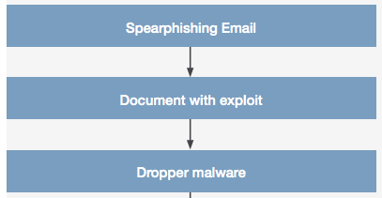
APT 28
Threat Actor
Russian Cyber Espionage Group
Targets: Insider information related to governments, militaries, and security organizations.
Known For: Reportedly compromising the Hillary Clinton Campaign in attempt to interfere with the 2016 U.S. Presidential election.
Highlights: Active since 2004, Skilled, Creative, Tactical. Known for developing sophisticated tools.
Known Malware: “X-Agent, SOURFACE, CHOPSTICK, EVILTOSS, CORESHELL”
Tactics: Stealing credentials through spoofing web-based email services.
Social Engineering (Fake Online Profiles)
Spearphishing
Embedded links
Malware download/exploit
Keylogging
Screenshots

Slide 3
APT 28
Damage Dealt
What was collected and pwned
Bootkits: deployed a bootkit along with Downdelph to ensure its persistence on the victim. The bootkit shares code with some variants of BlackEnergy
Scripting: APT28 loader Trojan uses a batch script to run its payload. The group has also used macros to execute payloads
Template Injection: used Microsoft Word template function to retrieve a malicious macro
Data Collecting:
has retrieved internal documents from machines inside victim environments, including by using Forfiles to stage documents before.
collect the entire contents of an inserted USB device.
has collected emails from victim Microsoft Exchange servers.
has collected information from Microsoft SharePoint services within target networks
Valid credentials through spearfishing links or attachments

Slide 4
Risk Mitigation

Slide 5
https://www.justice.gov/file/1080281/download
https://attack.mitre.org/groups/G0007/

